Slide 1
Topic: Electricity EQ: How do I compare Energy used by Appliances?
Mrs Parlevliet
Year 11 Essentials

Slide 2
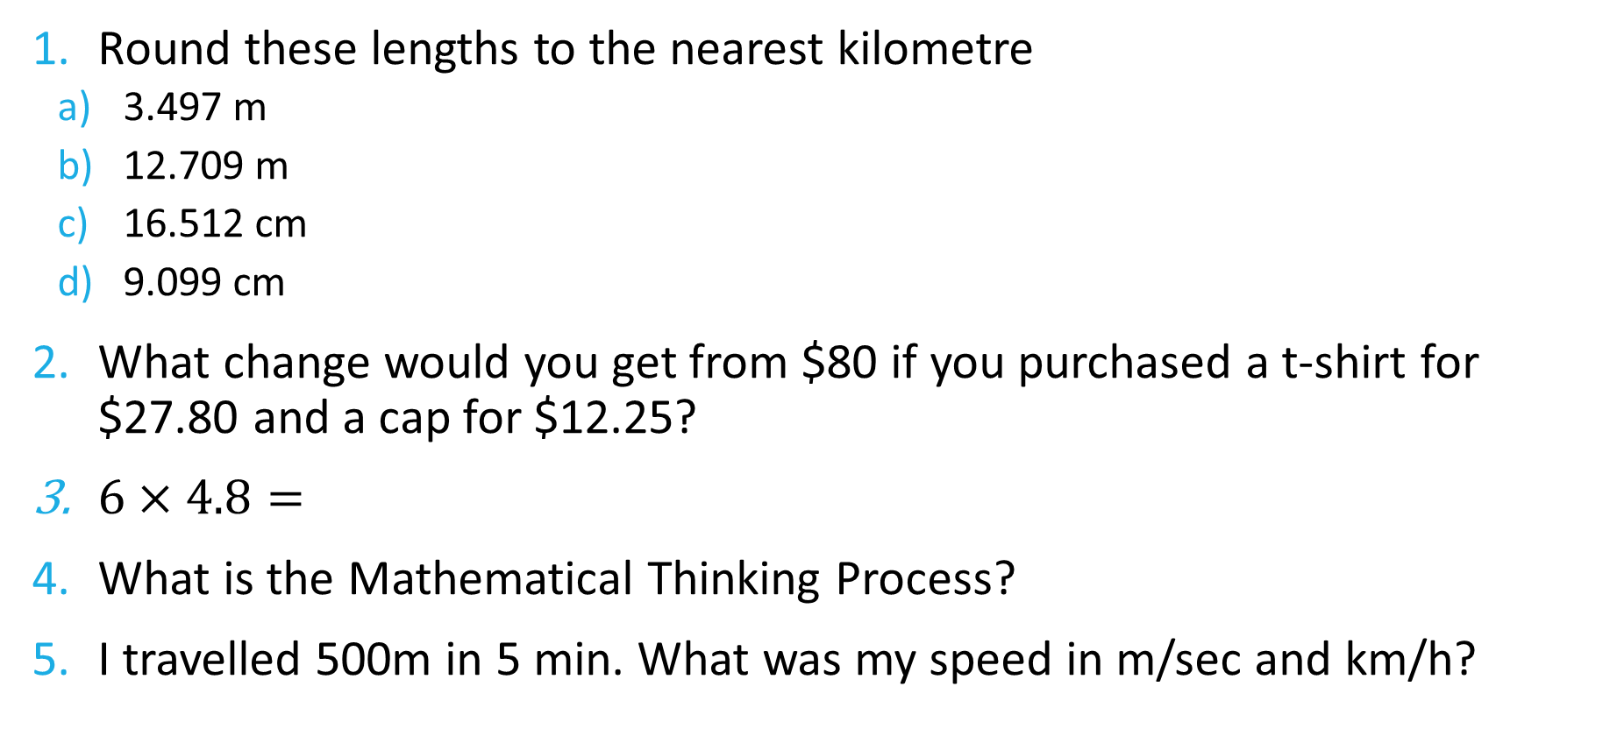
FiVe Questions
Round these lengths to the nearest kilometre
3.497 m
12.709 m
16.512 cm
9.099 cm
What change would you get from $80 if you purchased a t-shirt for $27.80 and a cap for $12.25?
$6×4.8=$
What is the Mathematical Thinking Process?
I travelled 500m in 5 min. What was my speed in m/sec and km/h?

Slide 3
24
7
30
Topic: Electricity
Date: XX/XX/2021
EQ – How do I compare energy used by appliances?
What is the Mathematical Thinking Process?
The Mathematical Thinking Process is made up of the following steps:
Interpreting the Task
Identify the mathematics involved
Analyse the information and data involved which may require you to research and find the information needed
Apply mathematical knowledge and strategies to calculate values to arrive at the answer or answers to the problem
Verify the reasonableness of your answer
Communicate these findings in a suitable format
WICOR

Slide 4
24
7
30
Topic: Electricity
Date: XX/XX/2021
EQ – How do I compare energy used by appliances?
Most appliances in Australian that consume large amounts of energy are required to carry an energy rating label. This label provides a simple star system for comparing the energy efficiency of the appliance to other similar products, and also gives the expected energy consumption per year.
WICOR

Slide 5

Energy Rating Level
https://www.youtube.com/watch?v=G5KPNYcHCNg

Slide 6
24
7
30
Topic: Electricity
Date: XX/XX/2021
EQ – How do I compare energy used by appliances?
Calculating Cost of Electricity Used
Multiply the total amount of energy in kWh by the energy tariff which is the cost that is charged by the electricity provider.
In Western Australia for 2021 is 28.8719 cents per kWh.
WICOR

Slide 7
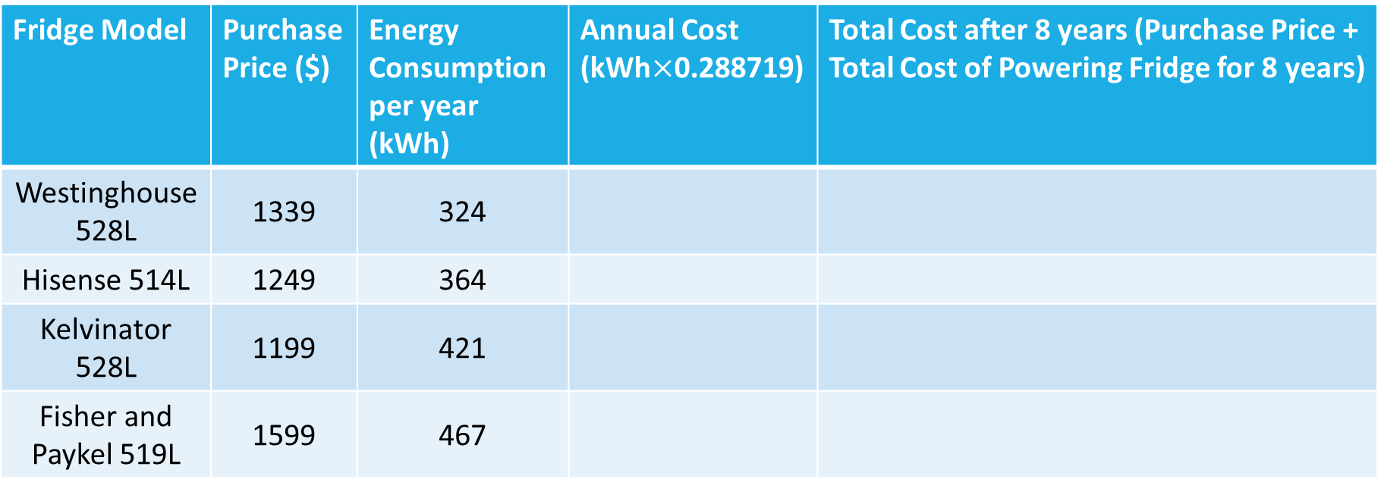
Task, (p. 79 of text)
Your task is to determine which of the following fridges is the best deal over an 8 year period. You need to prepare your answer using the Mathematical Thinking Process. The fridges are approximately the same size.
Fridge Model | Purchase Price ($) | Energy Consumption per year (kWh) | Annual Cost (kWh$×$0.288719) | Total Cost after 8 years (Purchase Price + Total Cost of Powering Fridge for 8 years)
Westinghouse 528L | 1339 | 324
Hisense 514L | 1249 | 364
Kelvinator 528L | 1199 | 421
Fisher and Paykel 519L | 1599 | 467

